Slide 1
Platform Feedback Analysis

Slide 2

Moringa School Feedback Data Analysis and Recommendations

Slide 3

Feedback Categorization
1. Feedback grouped into categories:
Highly Useful (6-7): 199 responses
Useful (4-5): 42 responses
Maybe Useful (1-3): 17 responses
2. Visualized with bar and pie charts for clarity.
3. Key Insight: Over 74% rated the platform as Highly Useful.

Slide 4
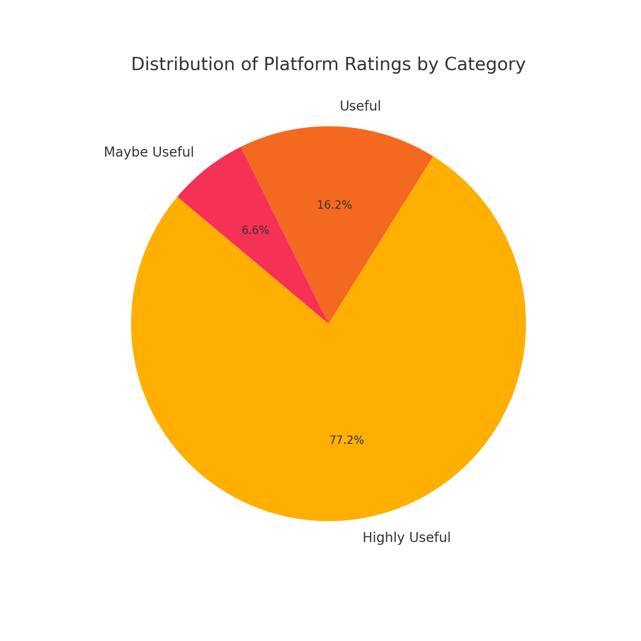
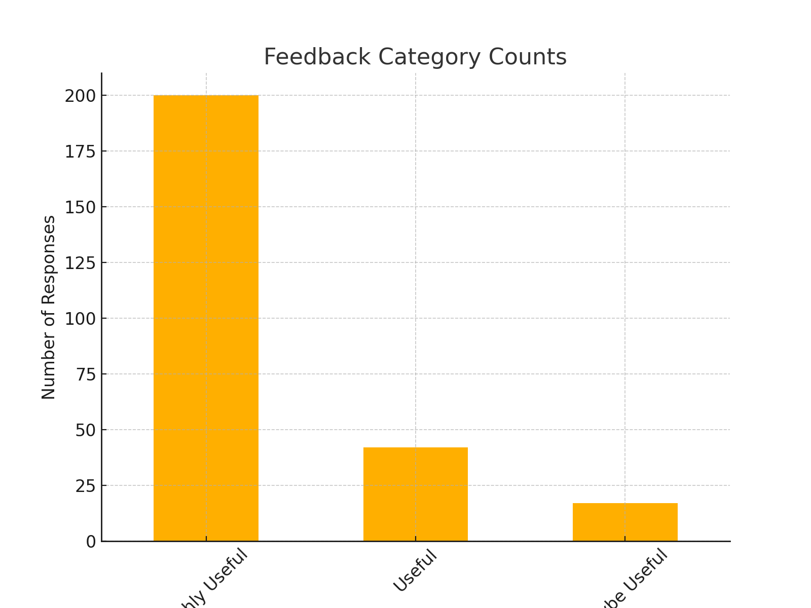
Feedback Category Charts

Slide 5
Feedback Form Recommendations
Add open-ended questions to capture specific insights.
Introduce Likert scales for detailed feature analysis.
Gauge emotional responses to understand engagement.
Include Net Promoter Score (NPS) questions.
Ask for specific improvement suggestions.

Slide 6
Recommendation Likelihood Analysis
1. Estimated likelihood to recommend: 77.1%.
2. Based on ratings of 6-7 indicating strong advocacy.
3. Recommendations for better insights:
Add direct recommendation questions.
Include NPS for precise segmentation.
Ask about referral feature improvements.

Slide 7
THANKS!

